Slide 1
Teaching Model-Based Systems Engineering with MATLAB & Simulink for Smart Energy Systems
Faculty of Engineering

Slide 2
Índice
Context
Systems engineering with models and MATLAB & Simulink.
Curriculum description
Requirement management.
Management and design of architectures.
Testing, verification and validation.
Conclusions

Slide 3
Context
1

Slide 4
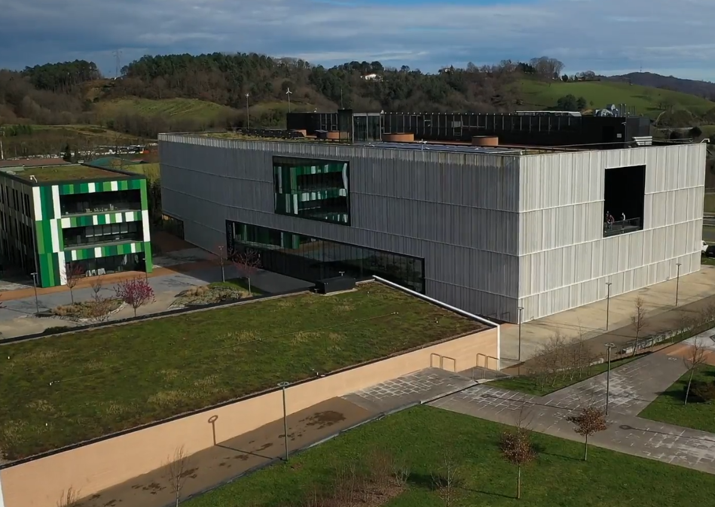
Context
In 2021 the engineering faculty begins to think about a new official master's degree for the Galarreta campus (Hernani).
Some of the topics to be addressed were:
Systems engineering.
Model-based design.
Validation and verification tools.

Slide 5
Context
Industrial companies are responsible for the entire life cycle
life cycle
V model
Validation
Definition and decomposition
Integration, verification and validation
The V-model is a methodology for life cycle management.

Slide 6
Learning outcomes
Manage the life cycle with the V-model and model-based techniques.
Requirements writing and management.
Composition of system architectures and organization of components.
Organization of verification and validation tests of system requirements with test harnesses and test suites.

Slide 7


Collaboration with MathWorks
There was a need for a tool to work on these concepts with the students.
They previously have experience with MATLAB & Simulink.
A collaboration with MathWorks was initiated for the development of this curriculum.
The curriculum was developed following the example of a scooter development process.
Contexto
Ingeniería de sistemas
Descripción del currículum
Conclusiones

Slide 8
Model-Based Systems Engineering with MATLAB & Simulink
2

Slide 9

Systems engineering
Until a few years ago, the life cycle was managed on a document basis.
Requirements document
Architecture document

Slide 10
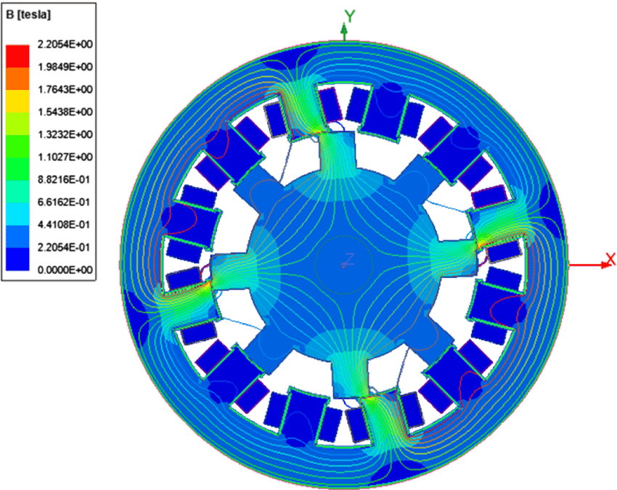
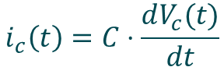
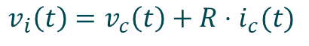
Model-based systems engineering
Models are increasingly being used
model = physical, mathematical or logical representation of a system
$$i_{c}\left(t\right)=C⋅\frac{dV_{c}(t)}{dt}$$
$$v_{i}\left(t\right)=v_{c}\left(t\right)+R⋅i_{c}(t)$$

Slide 11
Model-based systems engineering
The use of models has given rise to Model-Based Systems Engineering (MBSE).
MBSE = the formal application of modeling to support requisitioning, design, analysis, verification and validation activities.
model

Slide 12
Model-based systems engineering
How do MATLAB & Simulink help?

Slide 13
Curriculum description
3

Slide 14
Curriculum description
The following modules have been integrated into one subject:
Module 1. Introduction to model-based systems engineering.
Module 2. Requirements management and writing.
Module 3. Management and design of architectures.
Module 4. Integration, verification and validation.
Content to be taught in 30 hours.
The didactic material consists of:
Presentations on theoretical content.
Exercises to do in class.
Statements and solutions for practical activities.

Slide 15
How to use this material
The following modules have been integrated into one subject:
Module 1. Introduction to model-based systems engineering.
Module 2. Requirements management and writing.
Module 3. Management and design of architectures.
Module 4. Integration, verification and validation.
Content to be taught in 30 hours.
The didactic material consists of:
Presentations on theoretical content.
Exercises to do in class.
Statements and solutions for practical activities.

Slide 16
Cómo utilizar este material
The order of the classes follows the life cycle. Each module is taught according to the order of the previous slide (Introduction, requirements, architecture and validation).
There are theoretical presentations to work on the basic concepts:
1.1 Fundamentals of Model Based Systems Engineering for Life Cycle Management. (additionally, there is a document with extended information).
2.1 Writing requirements
3.1 Architecture management
There are practical presentations that are combined with the MATLAB project to practice with the different tools:
2.2 Requirements management in MATLAB
3.2 Architecture management in MATLAB
4.1 Verification and Validation in MATLAB
The idea is that the teachers first give the theoretical presentations and then go on to practice with the MATLAB tools.

Slide 17
Module 2. Requirements
Objective 1: Establish the characteristics of a good requirement.
Feasible
Verifiable
Non ambiguous
Clear
Atomic
Legal
Abstract
Complete

Slide 18
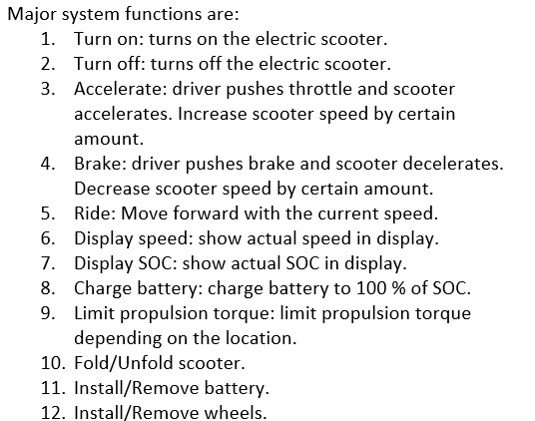
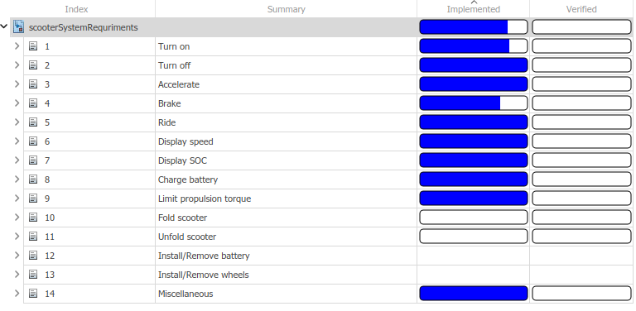
Module 2. Requirements
Objective 2: Establish a process for writing requirements.
Define boundary and limits
Identify users and use cases
Identify functions
Identify requirements per function

Slide 19
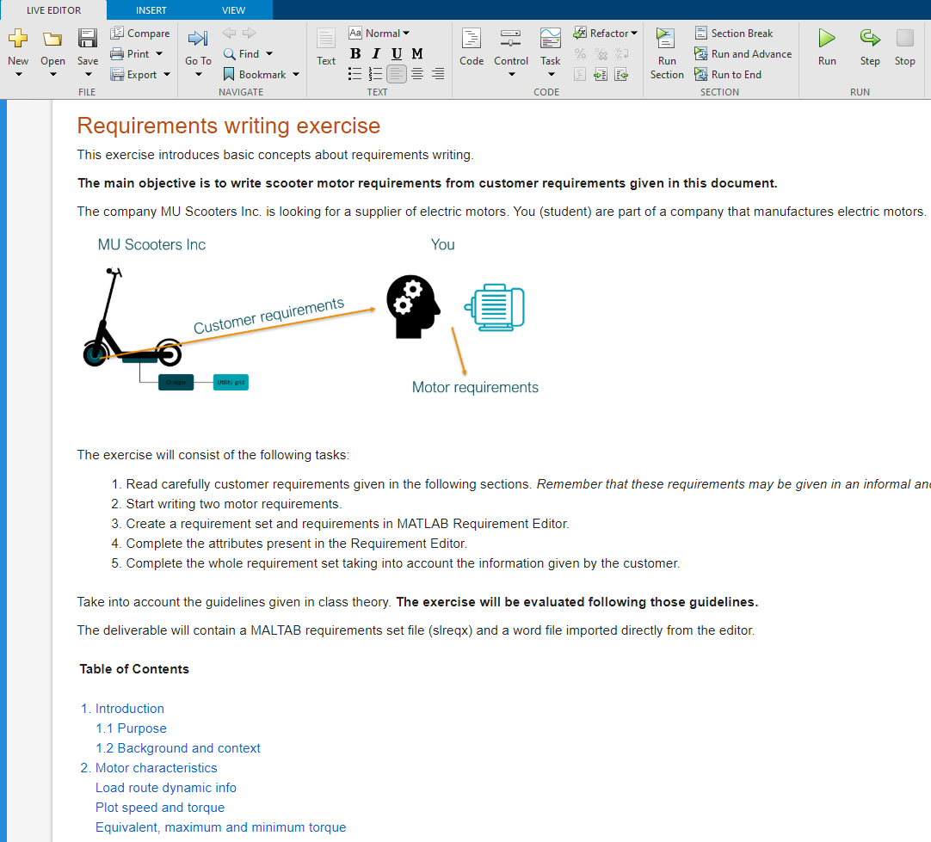
Module 2. Requirements
Different exercises have been developed
deliverable: requirements set

Slide 20
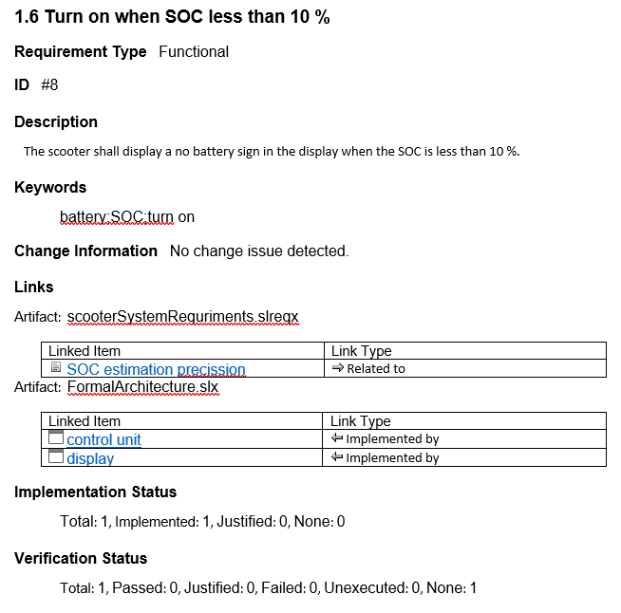
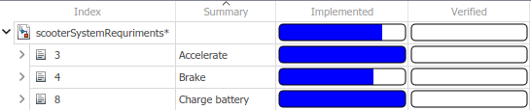
Module 2. Requirements
Requirements Toolbox tiene diferentes funcionalidades:
Requirements creation: Writing and organizing requirements.
Linking requirements: Link requirements to architectures, designs and tests.
Analyze requirements: Traceability and analysis matrices.

Slide 21
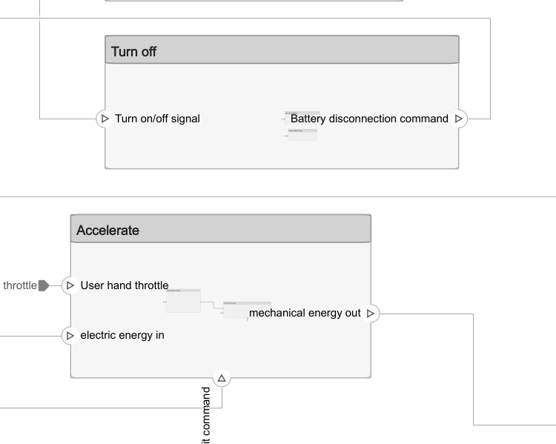
Module 3. Architecture
Objective 1: Analyze what an architecture is and what forms it takes.
Function
Form

Slide 22
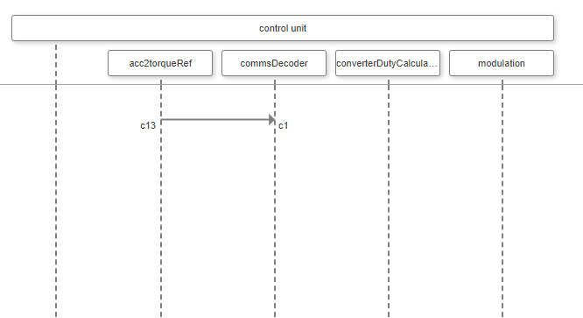
Module 3. Architecture
Objective 2: Analyze different views

Slide 23
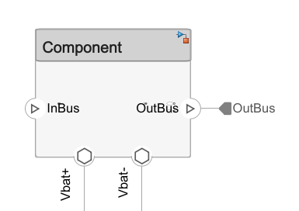
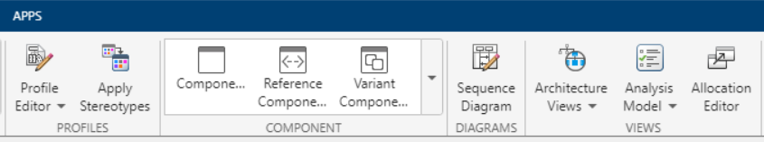
Module 3. System Composer

Slide 24
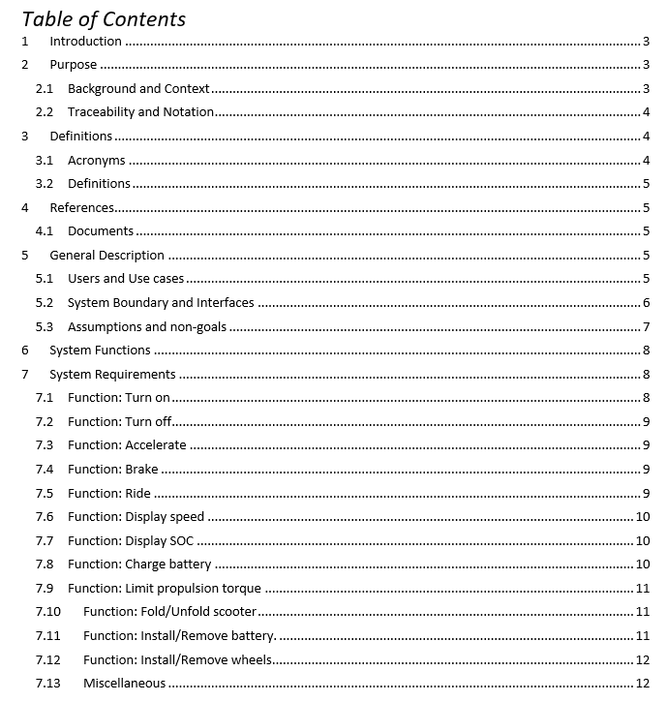
Modulo 3. Coursework
A practical exercise has been developed:
Tareas:
Crear un set de requisitos.
Crear arquitectura functional.
Crear arquitectura formal.
Enlazar requisitos a components.
Enlazar modelo de comportamiento.

Slide 25
Module 4. Verification and validation
Objective 1: Analyze and understand the bottom-up strategy for integration.
Arneses de prueba

Slide 26
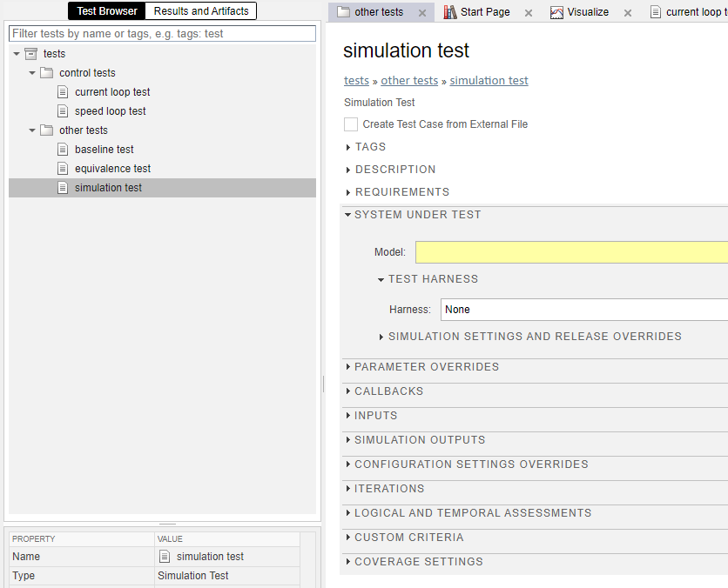
Module 4. Verification and validation
Objective 2: Test automation and linkage with requirements.

Slide 27
Conclusions
4

Slide 28
Conclusions
MATLAB & Simulink are suitable tools to get started in model-based systems engineering.
If students are familiar with this software, they can start working without additional software.
It allows linking new knowledge with previous modelling knowledge.

Slide 29
Eskerrik asko
Muchas gracias
Thank you
Jon del Olmo Larrañaga
jdelolmo@mondragon.edu
Iosu Aizpuru
iaizpuru@mondragon.edu
Paul Aretxederreta
x.paretxederreta@mondragon.edu
Galarreta Campus
Jauregi Bailara, z.g.
20120 Hernani (Gipuzkoa)
Tel. : +(34) 943 739765
www.mondragon.edu

